Slide 1
Daily Scrum
08/04
Han Sang Lee Java A-4 SK Didimdol 4th hillofsky@naver.com

Slide 2
Task List
Assigned Task | Progress
Data Modeling: Class Diagram | 20%->30%
Database Design | 0%->50%
UI Design: 마이페이지, 개인정보수정 | 100%
Product Backlog 작성 | 100%

Slide 3
Yesterday’s Task
Today’s Task
Technical Issue

Slide 4
1. Yesterday’s Task
What I did?
Class Diagram 업데이트
DataBase 모델링 시작

Slide 5
1. Yesterday’s Task
How I did?
Class Diagram 업데이트
오타 수정
평점계산 메소드 추가
DataBase 모델링 시작
로컬 Oracle DB 설정
Oracle DB에 Airdnd 스키마 작성
Class Diagram 참조

Slide 6
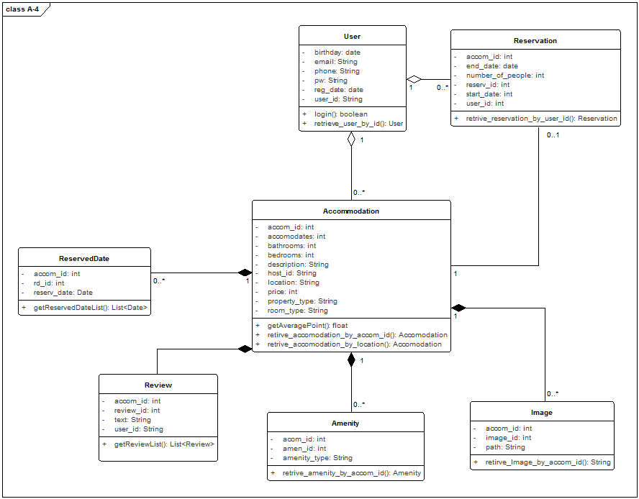
1. Yesterday’s Task
Result

Slide 7
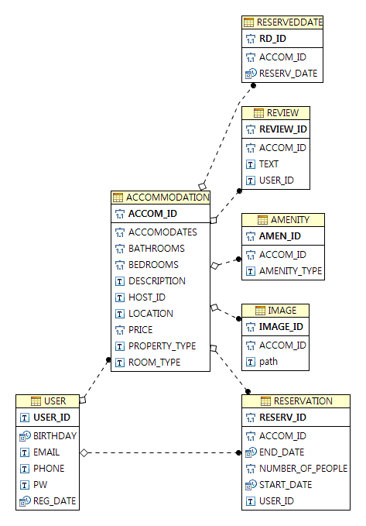
1. Yesterday’s Task
Result

Slide 8
Yesterday’s Task
Today’s Task
Technical Issue

Slide 9
2. Today’s Task
ToDo
DAO 작성 및 테스트
SRS 작성
개발환경세팅

Slide 10
Yesterday’s Task
Today’s Task
Technical Issue

Slide 11
3. Technical Issue
Issue
(None)

Slide 12
END

